Slide 1
Providing Privacy, Safety, and Security in IoT-Based Transactive Energy Systems using Distributed Ledgers
Abhishek Dubey Vanderbilt University | Aron Laszka University of Houston
In partnership with Siemens, CT

Slide 2
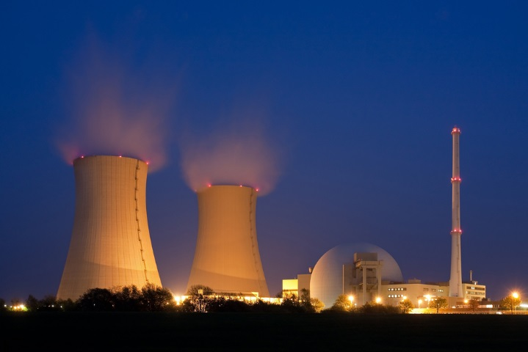

Electrical Energy Networks Are Changing
From centralized to decentralized and distributed energy systems
Changing Generation Mix
Transactive Energy
Electric Cars
Decentralization
DER-s

Slide 3
Decentralization is the big trend

Slide 4
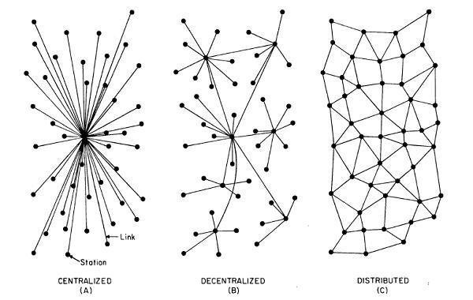
The Evolution of Energy Networks
Traditional networks with transmission system operators, distribution system operators & radial distribution systems to communities

Slide 5
The Evolution of Energy Networks
Advantages of decentralization
Improved cyber & physical reliability by removing single point of failures
Faster decision making by avoiding network penalties due to round-trip to the cloud
Improved scalability
Better integration with hierarchical control systems
Network of distribution feeders with some microgrids with tightly integrated distributed energy resources

Slide 6
The Evolution of Energy Networks
Trend
Traditional networks with transmission system operators, distribution system operators & radial distribution systems to communities
Network of distribution feeders with some microgrids with tightly integrated distributed energy resources
Network of transactive microgrids with limited role of distribution system operators

Slide 7
The trend of decentralization
Trend
Traditional networks with transmission system operators, distribution system operators & radial distribution systems to communities
Network of distribution feeders with some microgrids with tightly integrated distributed energy resources
Network of transactive microgrids with limited role of distribution system operators
This trend of decentralization can be seen around many other cyber-physical system applications, for example: smart manufacturing, smart cities, etc.

Slide 8
Smart Homes With Production and Delayed Consumption Capability are the Key to this new Trend

Slide 9
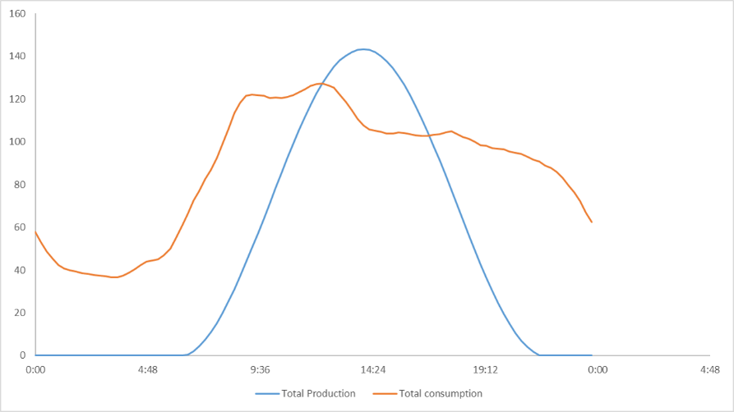
Smart Homes -> Smart Prosumers
Energy Exchange
Reduce Dependence of the Grid
A typical Generation and Consumption profile

Slide 10
Transactive Energy
A local energy market
A time synchronized distributed IoT Platforms problem.
Information privacy
A distributed protocol problem.
Assuring integrity of finalized transactions.
A decentralized management problem
Energy Exchange
Reduce Dependence of the Grid

Slide 11
Focus Challenge: Privacy
Information privacy
Leakage of energy usage patterns to other prosumers
Inference of future states of a prosumer Transactions
Transactions and energy
usage data in a transactive microgrid are much richer
sources of information than the simple usage data collected by smart meters
Energy Exchange
Reduce Dependence of the Grid

Slide 12
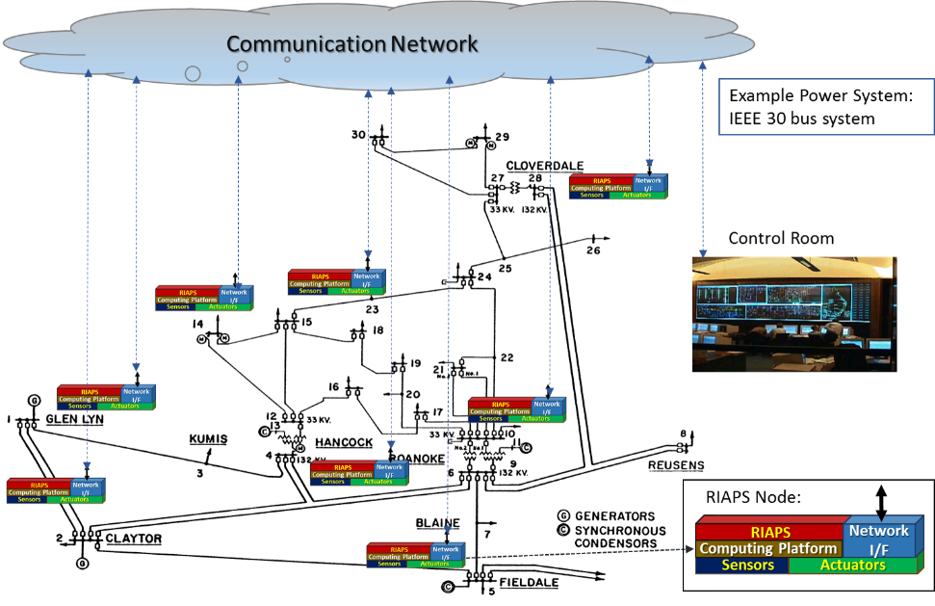
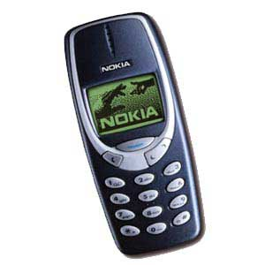

RIAPS: Our baseline system model
At the core of the RIAPS vision is a reusable technology stack to run Smart Grid software applications. A software platform defines:
Programming model (for distributed real-time software) on embedded nodes dispersed throughout the power grid.
Services (for application management, fault tolerance, security, time synchronization, coordination, etc.)
Development toolkit (for building and deploying apps)
Smart Device:
App platform
Device

Slide 13
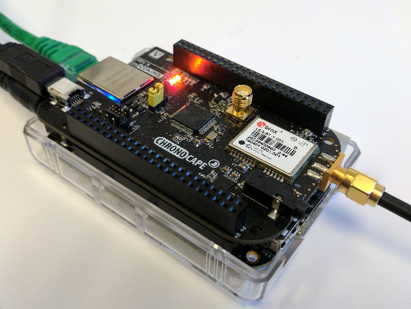
Petra Trading Platform and Distributed Ledger Architecture
We introduce PETra, a blockchain-based solution that enables consumers to trade energy without sacrificing their privacy and provides safety and security for the grid. It provides the following.
A RIAPS Node Participating in Petra-Enabled Transactive Energy Market
PETra

Slide 14
Petra Trading Platform and Distributed Ledger Architecture
We introduce PETra, a blockchain-based solution that enables consumers to trade energy without sacrificing their privacy and provides safety and security for the grid. It provides the following.
Bid Storage
by serving as a database for bids, enables prosumers to find trade partners without communicating with all potential partners
PETra

Slide 15
Petra Trading Platform and Distributed Ledger Architecture
We introduce PETra, a blockchain-based solution that enables consumers to trade energy without sacrificing their privacy and provides safety and security for the grid. It provides the following.
Bid Storage
Distributed Ledger
by serving as a database for bids, enables prosumers to find trade partners without communicating with all potential partners
stores transactions that specify energy trades, record energy production & consumption, financial records & regulatory policies for the microgrid
PETra

Slide 16
Petra Trading Platform and Distributed Ledger Architecture
We introduce PETra, a blockchain-based solution that enables consumers to trade energy without sacrificing their privacy and provides safety and security for the grid. It provides the following.
Bid Storage
Distributed Ledger
Controller (Future)
by serving as a database for bids, enables prosumers to find trade partners without communicating with all potential partners
stores transactions that specify energy trades, record energy production & consumption, financial records & regulatory policies for the microgrid
Stabilizes load within the microgrid & controls it based on the load in the rest of the grid
PETra

Slide 17
Petra Trading Platform and Distributed Ledger Architecture
We introduce PETra, a blockchain-based solution that enables consumers to trade energy without sacrificing their privacy and provides safety and security for the grid. It provides the following.
Bid Storage
Distributed Ledger
Controller (Future)
by serving as a database for bids, enables prosumers to find trade partners without communicating with all potential partners
stores transactions that specify energy trades, record energy production & consumption, financial records & regulatory policies for the microgrid
Stabilizes load within the microgrid & controls it based on the load in the rest of the grid
Smart Meters
smart meters must be tamper resistant to prevent prosumers from “stealing electricity” by tampering with their meters
PETra

Slide 18
The PETRA Protocol

Slide 19
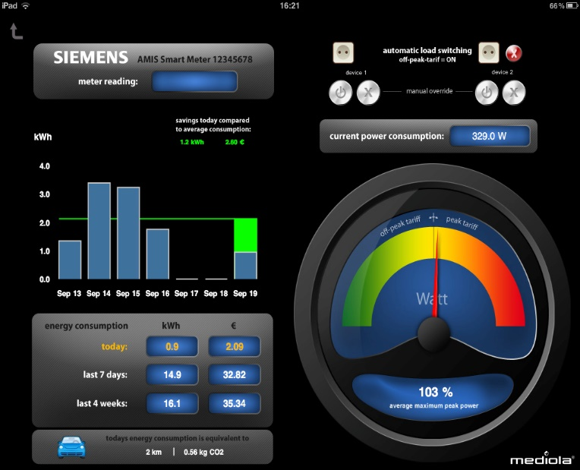
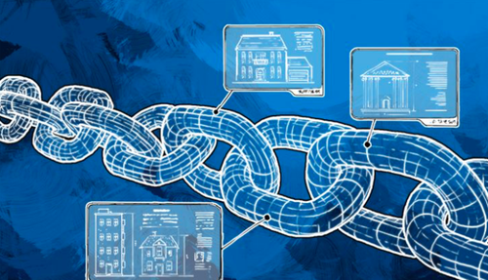
Security Assumptions
Billing is performed by the tamper proof smart meter based on the energy prices set by the DSO, the energy trades recorded in the blockchain and the energy transfer recorded by the smart meter
The regulatory policies are set by the DSO and are cannot be changed by others.
Prosumers cannot back out of trades unilaterally, and they can be banned by the DSO.

Slide 20
Privacy Guarantees
Only the corresponding smart meter and the DSO may gain information regarding the amount of energy produced, consumed, bought, or sold by a prosumer.
Only the prosumer may know which bids and asks it has posted, and no one can know who traded energy with whom.

Slide 21
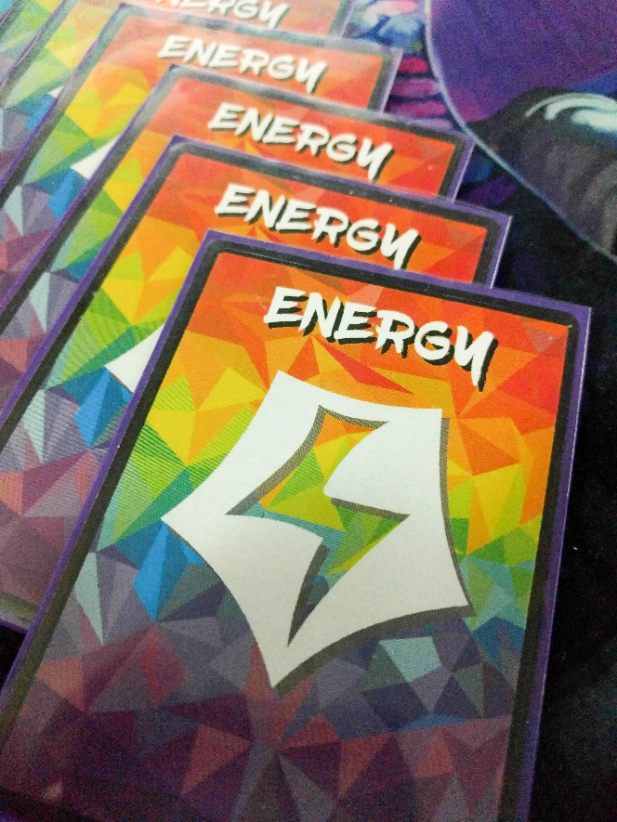
Energy Assets: Petra Key Concept
Energy is traded as quantized assets during fixed time intervals.
power: non-negative amount of power to be produced (for example, measured in watts),
start: first time interval in which energy is to be produced,
end: last time interval in which energy is to be produced.
A prosumer/consumer must validate and withdraw the asset from the smart meter before engaging in transaction.
Production asset
Consumption asset

Slide 22
Energy Assets: Petra Key Concept
Other tokens are financial, which are exchanged after settlement of trade.
All transactions are recorded in the distributed ledger.

Slide 23
Energy Assets: Petra Key Concept
Other tokens are financial, which are exchanged after settlement of trade.
All transactions are recorded in the distributed ledger.
Problem: All transactions in distributed ledger are public and can be traced back to the account holder

Slide 24

Using anonymous address and Mixing Services
Bitcoin and similar blockchain transactions provide pseudo anonymity
Each transaction is associated with a public account address of sender and receiver that enables correlation of trades
New addresses can be created. However, still patterns can be identified to cluster a number of similar transactions together, which can then be traced to an individual.
Mixing services such as zerocoin and Xim use accumulators and Zero Knowledge Proofs to mix a number of transactions together and then record them in the blockchain.
Due to this it is not possible to identify the individual transactions and perform data mining on them.
In Petra we provide for such a mixing service and use it to increase anonymity of the trades.

Slide 25
The full workflow

Slide 26
Petra Implementation 2.0 (DSO as Mixer)
DSO regulates using pricing and limiting asset withdrawals
Tracking anonymous energy assets enables enforcing safety requirements without violating prosumer privacy

Slide 27
Evaluation (since the paper was written)
We used real-world energy production/consumption data from a German microgrid
We deployed our system on a private Ethereum network
90% of trades were closed within 23 seconds or less

Slide 28
Summary
Information privacy
Energy assets and mixing services
Assuring integrity of finalized transactions.
Distributed ledger and tamper proof smart meters
Energy Exchange
Reduce Dependence of the Grid

